Slide 1
WELCOME TO EC LAB

Slide 2
Better Things
Punctual.
Dress Code.
Seating Arrangements.
Keep your belongings at specified places.
Before coming to lab go through the concepts which you will going to do in Lab.
Use paper and pen instead of Mobiles.

Slide 3
SAFETY PRECAUTIONS
Never make wiring changes on live circuits. Work deliberately and carefully and check your work as you proceed.
Before connecting the power, check your wiring carefully for agreement with the wiring diagram for an accidental short-circuit and for loose connections.
Make sure that your hands are dry. Resistance of wet skin can be as low as 1 kOhm as opposed to dry skin which is about 500 kOhm.

Slide 4

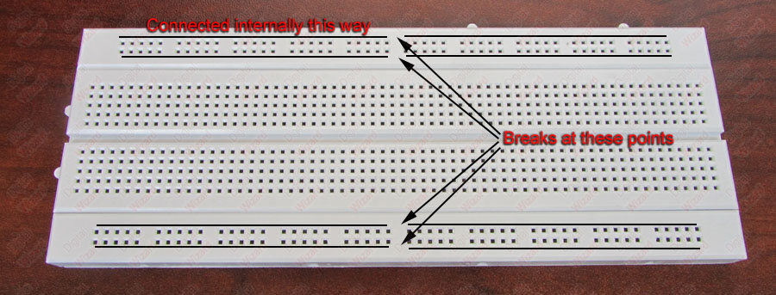
Bread Board

Slide 5
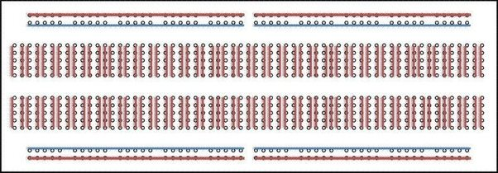
Internal Structure of Bread Board

Slide 6
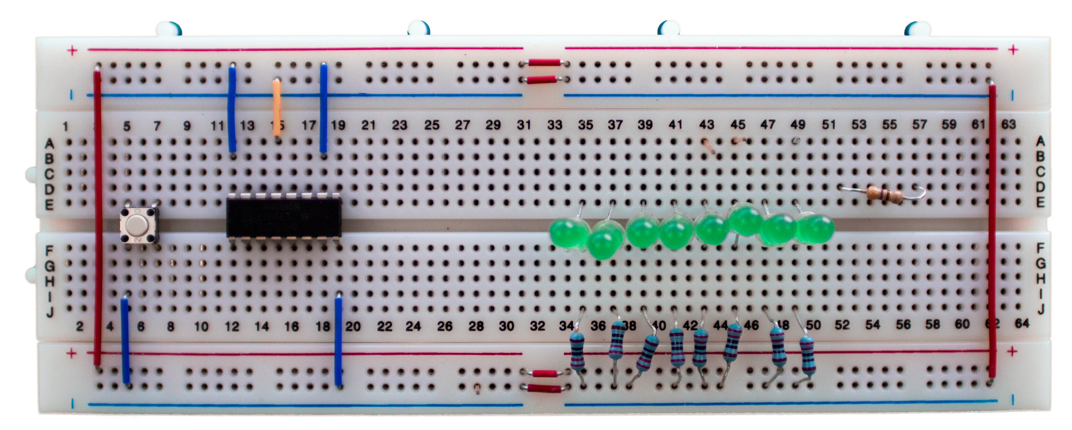

Slide 7
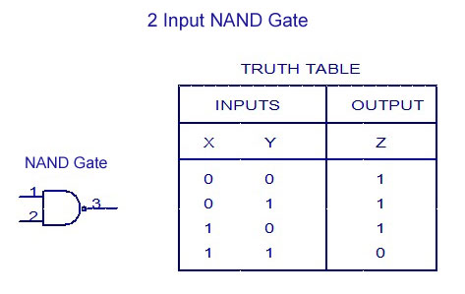

Slide 8
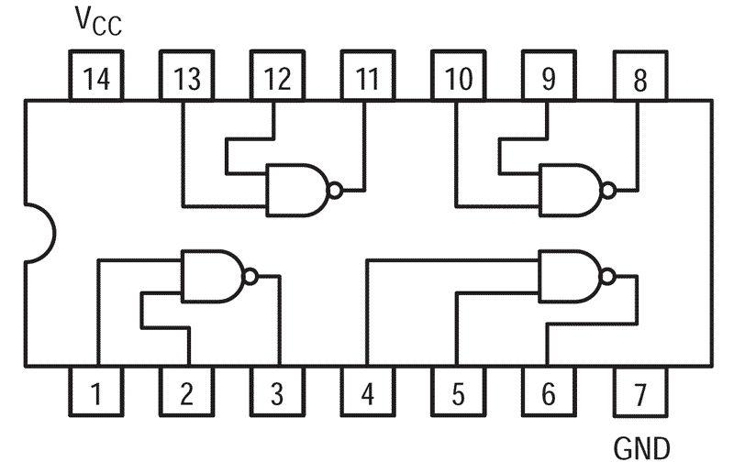

7400(NAND GATE)

Slide 9
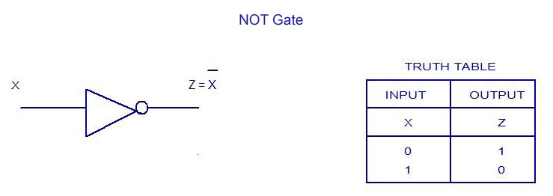

Slide 10
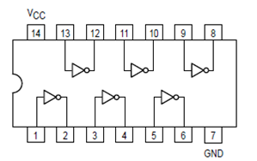
(7404) NOT GATE

Slide 11
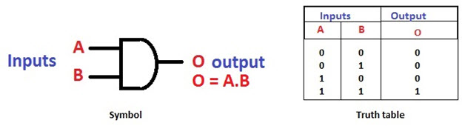
2 Input AND Gate

Slide 12
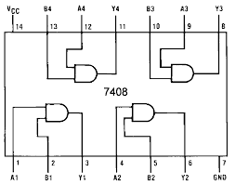
(7408) 2 INPUT AND GATE

Slide 13
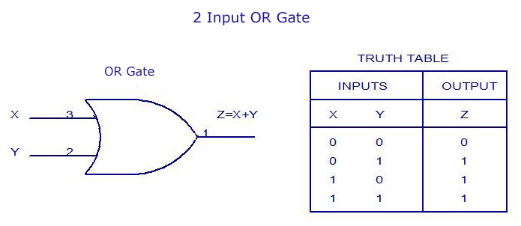

Slide 14
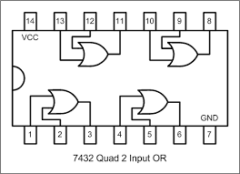
(7432) 2 INPUT OR GATE

Slide 15
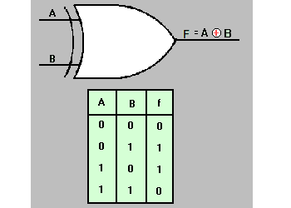
2 Input XOR Gate

Slide 16
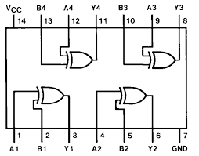
(7486) 2 INPUT XOR GATE

Slide 17
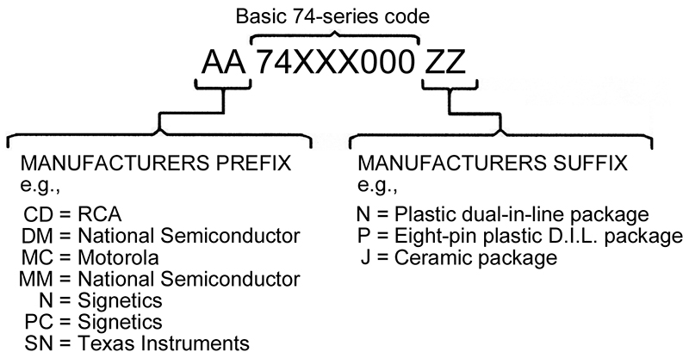

Slide 18
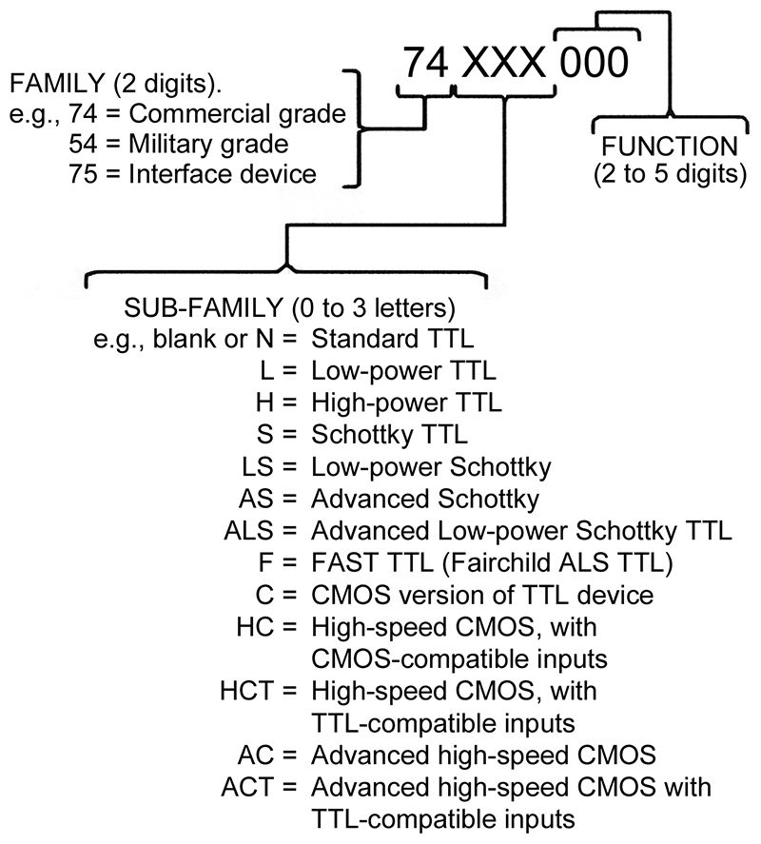

Slide 19
Thankyou

